Slide 1
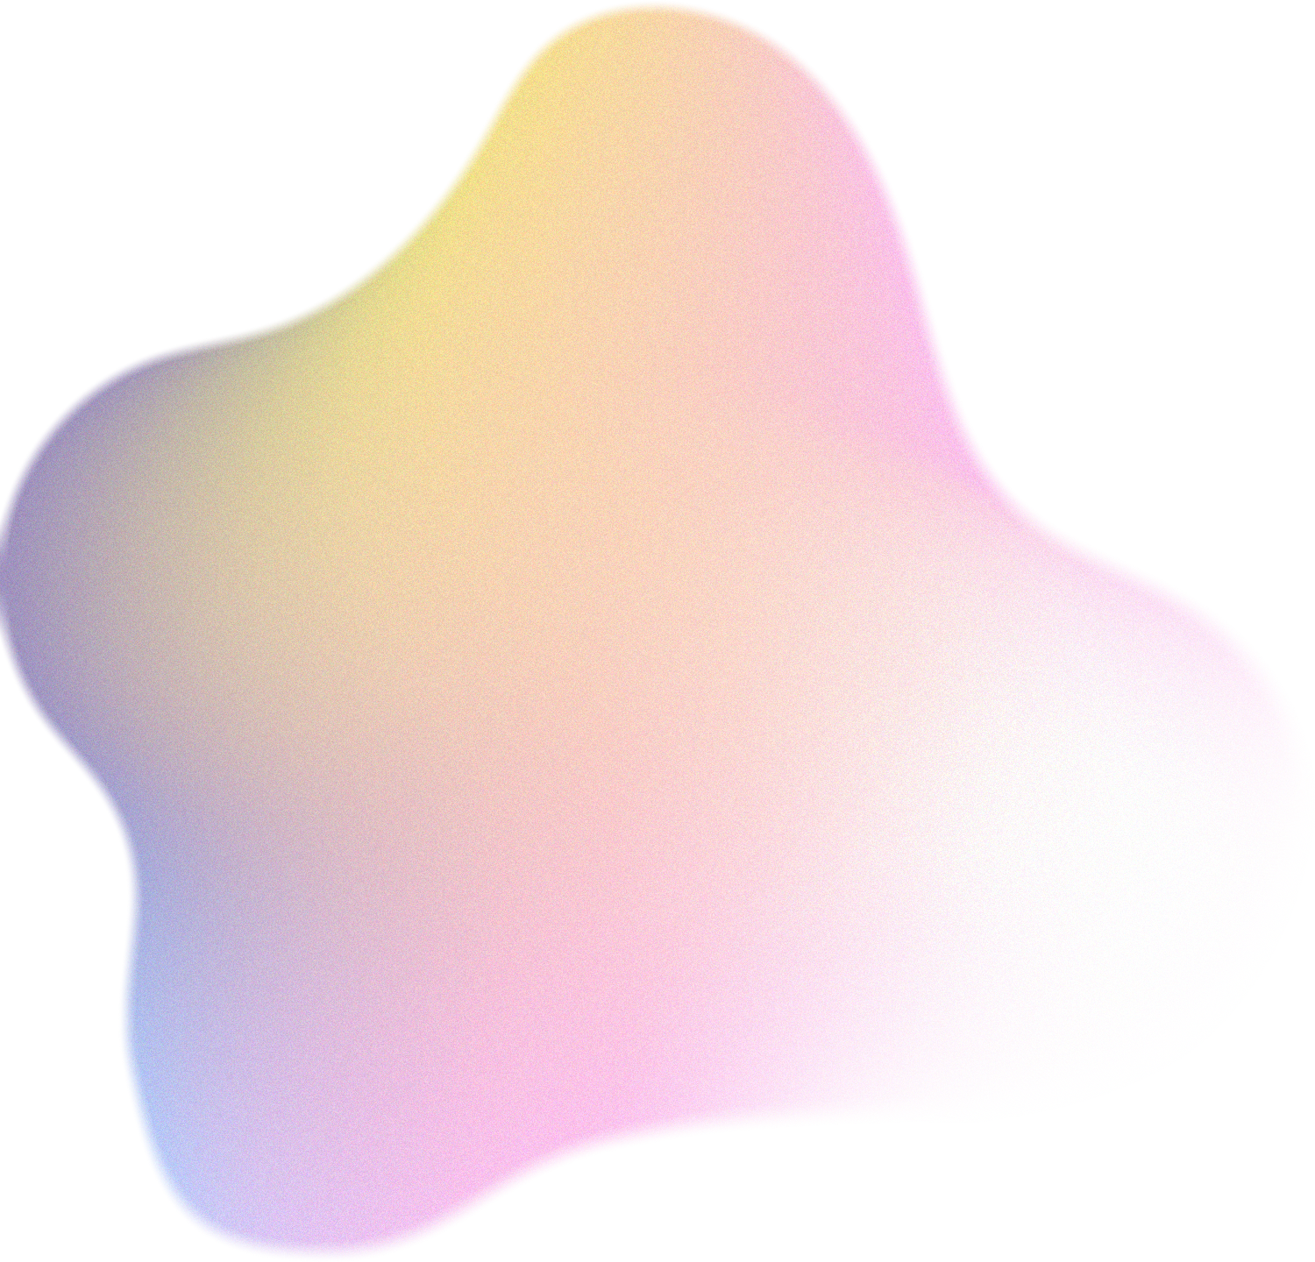
Deep Reinforcement Learning and NOMA-Based Multi-Objective RIS-Assisted IS-UAV-TNs: Trajectory Optimization and Beamforming Design
by Rishit Mane, Kushagra Singh, Kafil Abbas Momin, Himanshu Khatri.

Slide 2

Introduction to Problem Statement
Approach/Algorithm Used
Implementation and Inference
Agenda
Extensions and Future Directions

Slide 3


Context & Motivation
Challenges in RIS-Assisted UAV-Satellite-Terrestrial Networks
Growing Demand:
IoT/IoV applications require ubiquitous connectivity, high data rates, and low latency.
Limited spectrum and energy constraints challenge traditional networks.
Integrated Networks:
Satellite provides wide-area coverage, UAV acts as a flexible relay, and terrestrial users (VUs) require reliable links.
Obstacles (buildings, terrain) and dynamic UAV mobility disrupt line-of-sight (LoS) communication.
Key Limitations:
Spectrum scarcity: Orthogonal multiple access (OMA) inefficiently serves massive users.
Energy consumption: UAV propulsion and communication drain limited onboard energy.
Channel instability: UAV mobility causes rapid channel fluctuations.

Slide 4
Key Challenges & Problem Statement
Why Joint Optimization of UAV Trajectory, RIS, and Beamforming?
Critical Challenges:
Challenge 1: Obstacles block direct satellite-to-VU links.
Challenge 2: UAV mobility creates dynamic, non-stationary channels.
Challenge 3: NOMA requires precise power allocation and interference management.
Problem Gap:
Existing solutions optimize one variable at a time (e.g., trajectory OR beamforming).
High-dimensional, non-convex coupling of variables (trajectory, RIS phase shifts, beamforming) makes traditional optimization intractable.
Paper’s Goal:
Develop a multi-objective DRL framework (MO-DDPG) to jointly optimize:
UAV trajectory (minimize energy).
RIS phase shifts (enhance signal reflection).
Satellite beamforming (maximize NOMA efficiency).

Slide 5
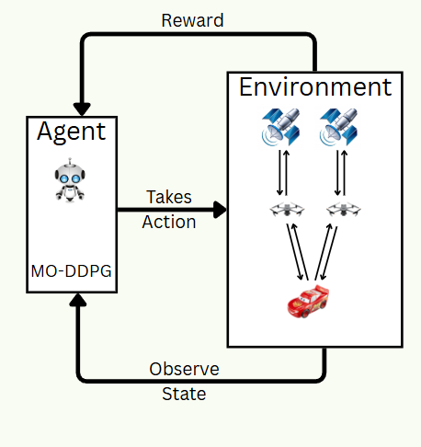
Proposed Algorithm: Environment and MO-DDPG Integration
Environment: A simulated space where agents interact, take actions, and receive feedback (rewards) — e.g., OpenAI Gym, custom trading simulator, or robotics simulation.
MDDPG: A reinforcement learning algorithm that extends DDPG to multi-agent systems, allowing agents to learn policies in environments with multiple interacting agents.
Objective: Train agents to learn optimal behaviors through continuous action spaces in a shared or competitive environment.

Slide 6
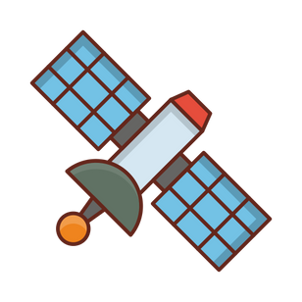
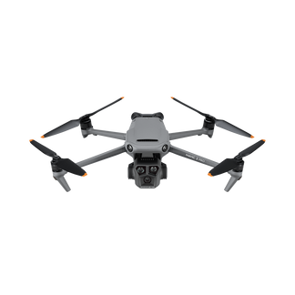
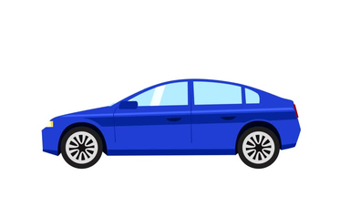
Environment Overview
Key Components:
Satellite: A geostationary satellite which is at a fixed position.
UAV: Acts as a flying base station with controllable position.
RIS: 2D passive reflective array to enhance signal strength.
Vehicle Users (VUs): Ground users moving randomly within a 2D area.
Communication Paths:
Direct Path: Satellite → VUs
Reflected Path: Satellite → RIS → VUs
Optimization Goals:
Maximize signal quality at VUs
Optimize UAV trajectory, RIS phases, and power allocation
1
2

Slide 7
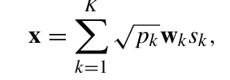
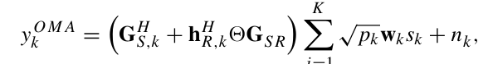
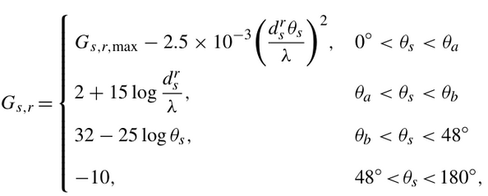
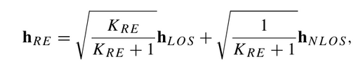
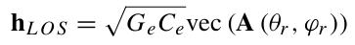
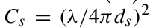
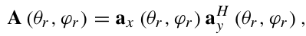
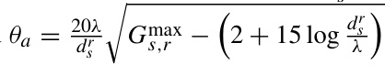
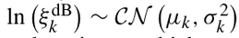
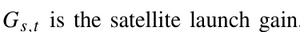
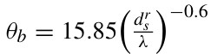
Mobility & Channel Modeling
1)
Vehicle User Mobility:
Random speed (10–30 m/s) and direction
Updates position each time step
Changes direction periodically
2)
3)
Channel Modeling:
Satellite → RIS: Distance-based path loss, rain attenuation, random phase
RIS → VU: Rician fading (LOS + NLOS), calculated using RIS geometry
Satellite → VU: Directional beam pattern with attenuation and distance loss
a)
b)
c)

Slide 8
Reinforcement Learning Setup
Action Space (Agent controls):
UAV movement: 2D vector
RIS phase shifts: Array of phase angles [0, 2π]
Beamforming: Power allocation vector across VUs
Observation Space:
UAV location
RIS phase matrix
Power allocation vector
Channel gains (direct and RIS-assisted)
Previous actions for context
Output Per Step:
Effective user channel gains
Observation of system state
Reward (e.g., based on sum-rate, SNR, or power efficiency)

Slide 9
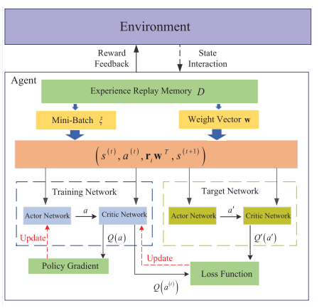
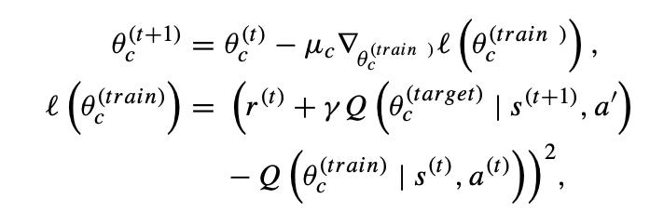
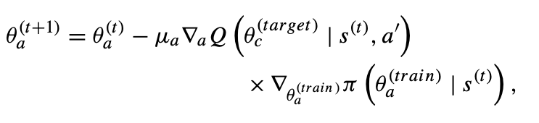
update strategy of the training critic network
The training actor network is updated using the following policy gradient

Slide 10
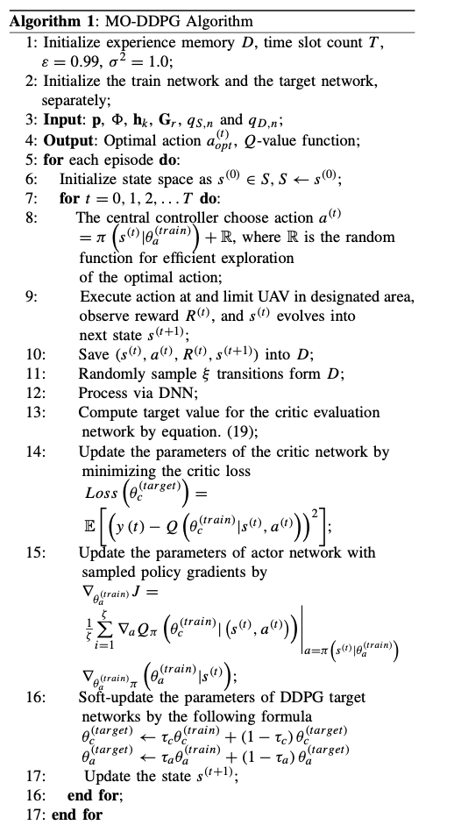
Pseudo Code for MO-DDPG Algorithm

Slide 11
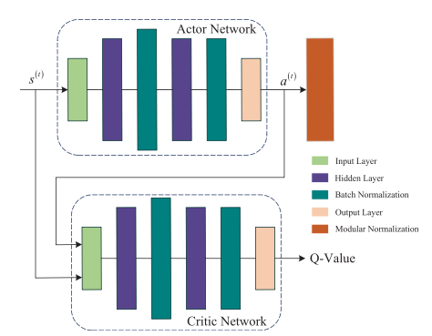
DNN structure of the Actor network and the Critic network

Slide 12
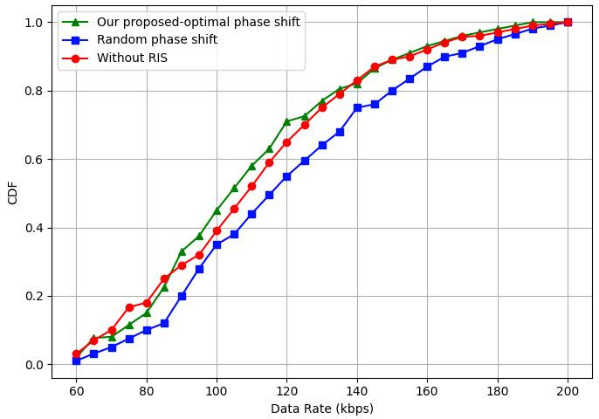
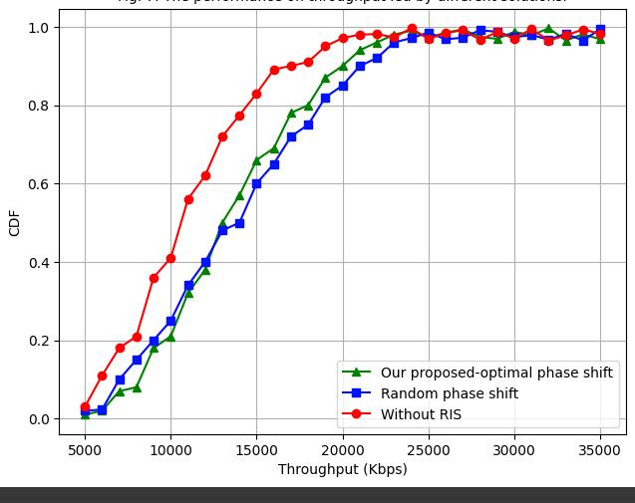
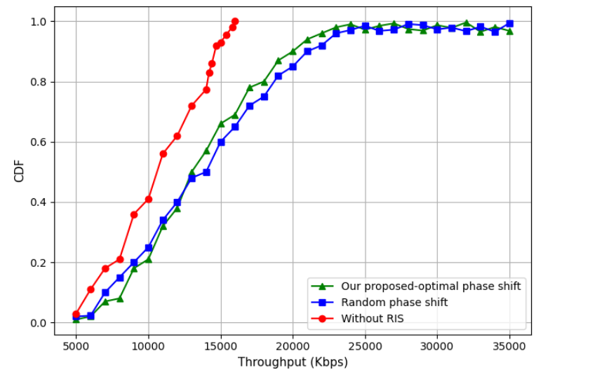
Results:
Data Rate Comparison
Throughput Comparison
• Highest data rate for optimized one due to improved signal alignment.
• Throughput is significantly higher, showcasing the system’s ability to handle more data traffic efficiently.

Slide 13
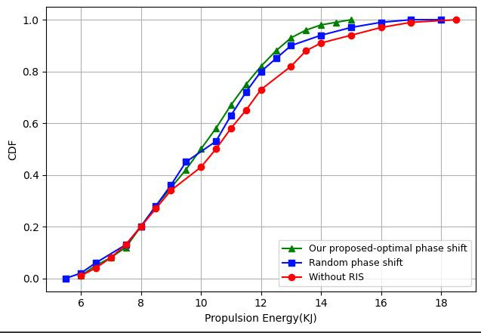
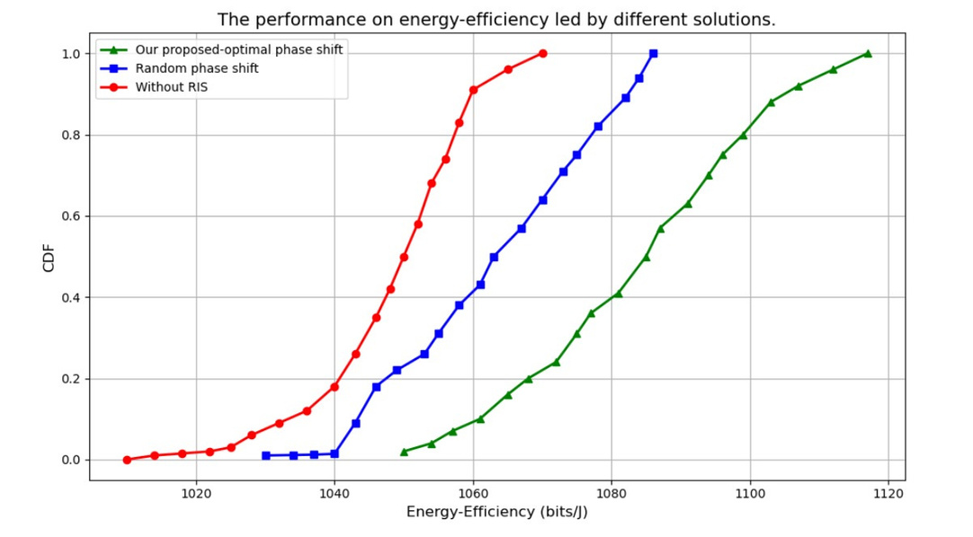
•Propulsion Energy
•Energy Efficiency
•The optimized phase shift scenario consumes the least propulsion energy, as the UAV can take shorter paths due to better signal paths.
• The RIS-assisted system with optimized phase shift offers the best energy efficiency by reducing unnecessary UAV movement.

Slide 14
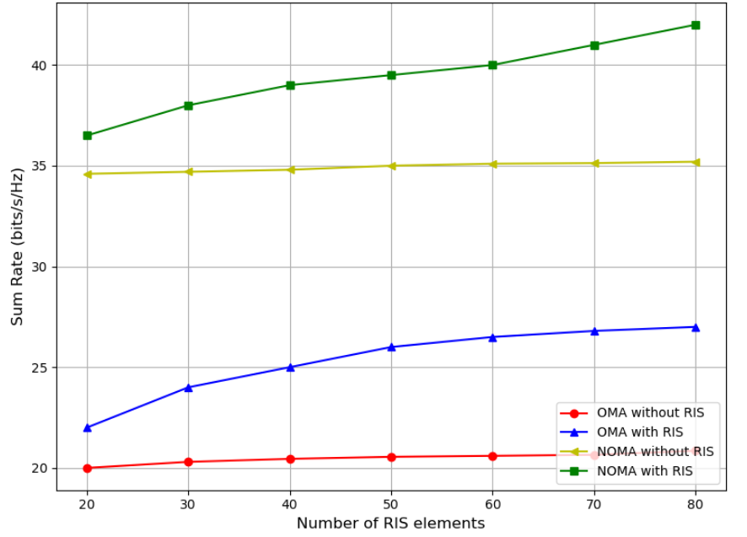
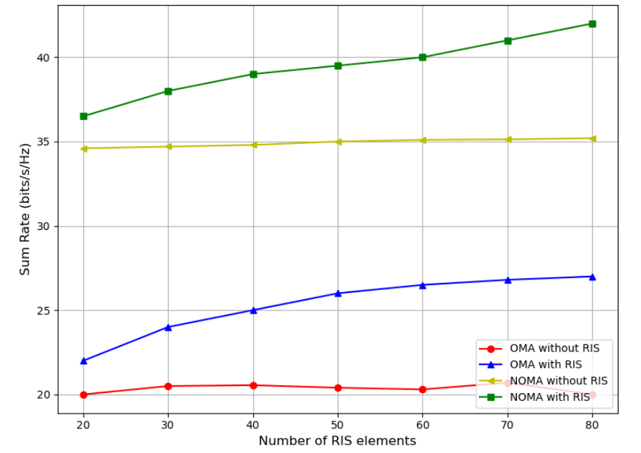
• Sum Rate Comparison
• The sum rate increases with more RIS reflective elements, and the NOMA protocol enhances spectral efficiency. The proposed RIS-assisted NOMA system achieves the highest sum rate, demonstrating the combined benefit of RIS and NOMA.

Slide 15
Future Works
Multi-UAV Coordination with RIS
Idea: Extend MO-DDPG to collaborative UAV swarms with distributed RIS units for enhanced coverage and robustness.
Challenge: Managing inter-swarm interference and ensuring real-time coordination in dynamic environments.
3D Trajectory Optimization
Idea: Optimize 3D UAV paths (altitude, roll/pitch) to avoid urban obstacles and enhance LoS.
Challenge: Increased action space complexity and energy trade-offs.

